Slide 1
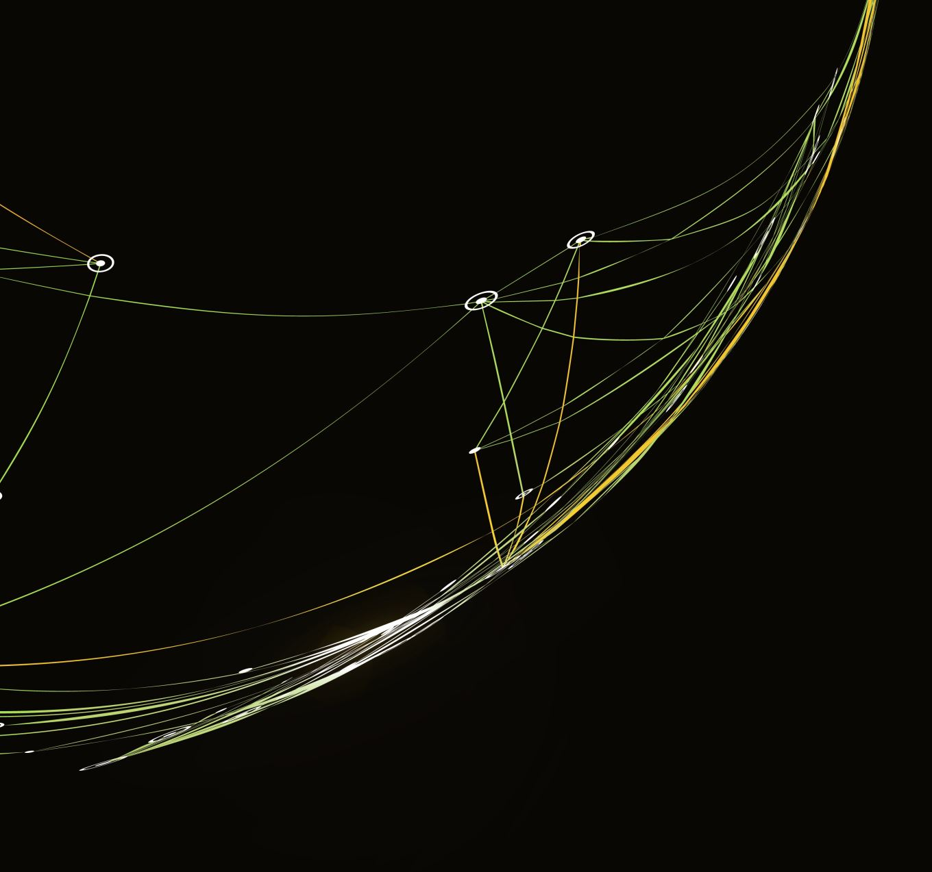
Disadvantages

Slide 2
Scalability
The model , requires very large computation , as the number of users grow more. The clustering will require more number of machines to do such computations.

